Slide 1
Scaffold-Based Analytics: Enabling Hit-to-Lead Decisions by Visualizing Chemical Series Linked Across Large Datasets
Deepak Bandyopadhyay,
Constantine Kreatsoulas,
Pat G. Brady, Genaro Scavello, Dac-Trung Nguyen, Tyler Peryea, Ajit Jadhav
Thanks to:
Lena Dang and Josh Swamidass (WUSTL),
Rajarshi Guha, Stephen Pickett, Martin Saunders, Nicola Richmond, Darren Green, Eric Manas, Todd Graybill, Rob Young, Mike Ouellette, Stan Martens, Javier Gamo, Lourdes Rueda
GSK
NCATS

Slide 2
Outline
Intro: analyzing and merging screening output
Methods for Scaffold-Based Analytics
Examples – Linking series across datasets
Hit Prioritization & Scaffold Hopping (TCAMS)
Dataset Integration & Scaffold Progression (Kinase “X”)
Conclusion

Slide 3
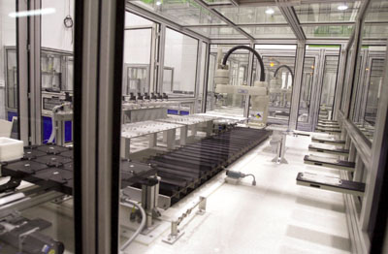
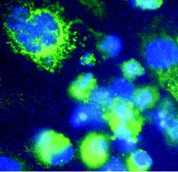
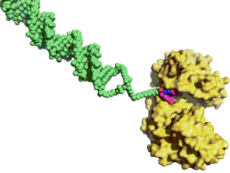
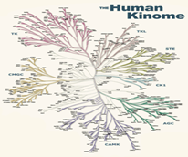
Small Molecule Lead Discovery at GSK
High Throughput Screening
Maximize chemical diversity
Fragment Hit ID
Low mol weight, ligand efficient starting points
High-Content / Phenotypic Screen
Disease-relevant assays
Target agnostic
GSK,
Tres Cantos,
Spain
DNA Encoded Library Technology (ELT)
Massive combinatorial libraries
Binders found by Next-Gen Seq.
Focused Screening
Compound sets tailored to target families
Small scale process
Screening output: large, diverse, and difficult to navigate

Slide 4
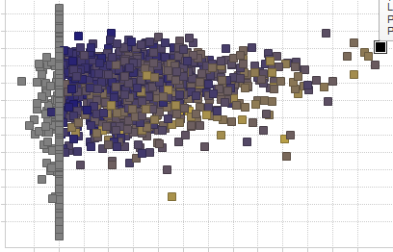
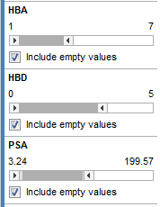
Historical Hit Triage - on Individual Compounds
Use case: isolate good chemical starting points and weed out bad ones
Criteria
Activity Data
Potency in a suite of assays
Selectivity against off-targets
Inhibition Frequency Index (IFI)
Physical/Chemical Properties
MW, solubility, permeability,…
Property Forecast Index (PFI)
Orthogonal assay (pIC50)
IFI (%) = # HTS assays Hit *100
# HTS assays Tested
Primary bioassay (pIC50)
Manual Data Surfing
PFI = Chromatophic LogD + # of aromatic rings
Lower PFI improves chances of positive outcome in phys/chem assays correlated with developability
Filters
IFI: S. Chakravorty, ACS New Orleans 2013
PFI: R. Young, D.V.S. Green, C. Luscombe, A. Hill. Drug Discovery Today. Volume 16, Numbers 17/18 September 2011 R
Notes:
Data visualization & exploration environment (we use Spotfire). PFI lipo akin to cLogP. Lower is better. 30 sec.

Slide 5


Datasets Used in this Presentation
Tres Cantos Anti-Malarial Set (TCAMS)
13.5k public compounds from GSK HTS
pIC50 against Plasmodium falciparum (PF) “susceptible” 3D7 strain
Percent inhibition against “resistant” DD2 strain
Other properties including IFI
In-house data on Kinase “X”
HTS, FBDD, ELT data
Hit
Prioritization
Scaffold
Hopping
?
Dataset
Integration

Slide 6
Outline
Intro: analyzing and merging screening output
Methods for Scaffold-Based Analytics
Examples – Linking series across datasets
Hit Prioritization & Scaffold Hopping (TCAMS)
Dataset Integration & Scaffold Progression (Kinase “X”)
Conclusion

Slide 7
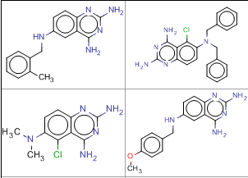


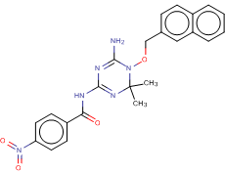
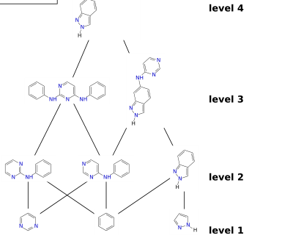
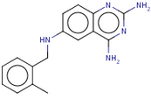
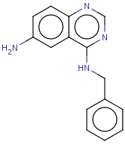
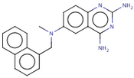
Automation is Necessary for Screening Hit Triage…
Manual selection and scaffold/R-group based SAR do not scale
5-50k molecules, 1000’s of chemotypes!
Traditional methods: clustering, substructure/similarity search, …
Agglomerative Clustering
Hierarchical Clustering
Multiple Substructure Searches
Scaffold
Network
(adapted
from J.
Swamidass,
swami.wustl.edu)
Similarity Search
0.9
0.75
SSS1
SSS2
SSS3
Manually Merge Results

Slide 8

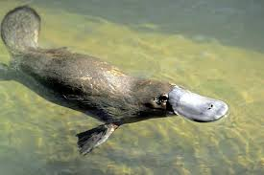



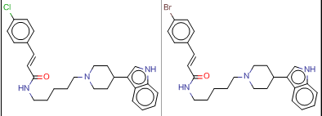
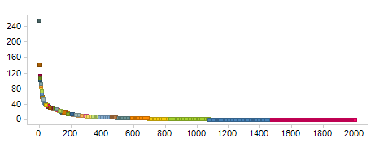
… But Clustering Is Not Sufficient for SAR Navigation
Molecule → single cluster, can be limiting
seals (fur)
Agglomerative Clustering:
Hierarchical Clustering:
Same underlying issues, adds complexity (level of hierarchy, e.g. # rings)
ducks
(bill)
?
?
?
?
penguins (flipper)
singleton
similar molecules ≠ same cluster
Many singletons
Cluster 3
Cluster 10
Cluster Size
Complete Link Cluster ID
Notes:
Adding the hier does not fix the agg isues, only adds complexity in navigation . Things at different levels may not be matched

Slide 9
Proposed Improvement: Automatic Decomposition into All (Overlapping) Scaffolds
PF 3D7 pIC₅₀
8.1
PF 3D7 LE 0.34
Molecule
Scaffold(s)
IFI
1.5%
Related Molecules
2 total
…
49 total
…
226 total
Notes:
What I will be describing is a method that exhaustively finds all possible shared (or common or frequent) substructures – which we call scaffolds within your data set using a tool from the NIH.
Here is a screening hit that I will use to demonstrate this.
… (don’t need to go into gory details)
Biaryl substructure is contained in these molecules that have low similarity to the original hit molecule.

Slide 10
Next Step: Combine with Activities and Properties
Avg pIC₅₀
8.15
Avg pIC₅₀
7.8
Avg pIC₅₀
7.8
Avg LE 0.46
Avg LE 0.45
Avg LE 0.32
Molecule
Scaffold(s)
Avg IFI
4.0%
Avg IFI
3.0%
Avg IFI
1.5%
Annotation
Related Molecules
8.2
0.31
8.2
0.51
7.5
0.6
8.5
0.47
7.9
0.57
1.5%
18.1%
2.9%
3.0%
7.7
0.36
7.4
0.56
8.5
0.58
8.0
0.57
1.5%
2 total
24.1%
1.5%
6.4%
2.1%
7.7
0.5
8.2
0.54
…
49 total
5.0%
4.4%
…
226 total
Notes:
We can aggregate activities & properties at the scaffold-level and then drill-down to the underlying data for individual compounds to progress scaffolds of interest.

Slide 11
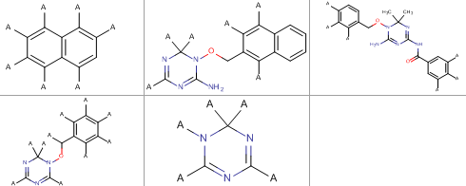
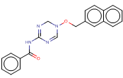
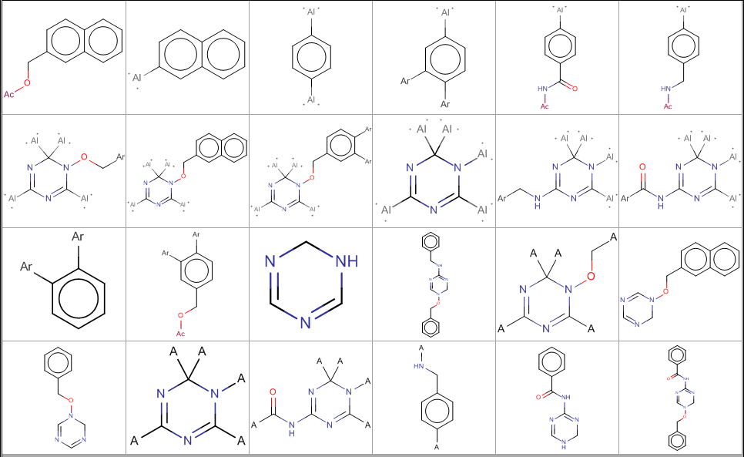

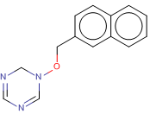


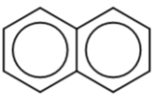
Methods Used to Exhaustively Generate Overlapping Scaffolds
1
Molecule
Scaffold(s)
NCATS
R-Group Tool
Related Molecules
SSSR scaffolds optimized for R-group tables
Rings
Scaffold
Network Generator
Hierarchical
Directed
Graph of
Scaffolds.
Scales
to large datasets
4
3
2
Frameworks (GSK) Bemis-Murcko like & RECAP
Exhaustive (pro: complete and con: redundant/too simple)

Slide 12

Details: Integrating Scaffold-Based Analytics into a Single Spotfire Visualization
Main Data Table: ChemBLNTD_TCAMS
Compound ID, SMILES, Properties, Activities
Molecule
Scaffold(s)
Compound ID
Cluster from Clustering
Frames from Data-Driven
Frameworks
Scaffolds from NCATS R-Group Tool
Top-Level Scaffold from Scaffold Network Generator
Annotation
Related Molecules
Method Specific Group IDs
Cluster ID, Cluster Size, Cpd IDs
Framework ID,
FW SMILES,
Cpd IDs
Properties & activities aggregated by scaffold
scaffold → subscaffold
n
Scaffold ID
(many)
subscaffold → scaffold
n
We found Scaffold Networks
complex
to integrate
& navigate…
Scaffold ID
(many)
Scaffold ID
(many)
Scaffold info:
IDs, SMILES Cpd Info: IDs, SMILES, Properties
Compound Exemplars from Top-Level Scaffolds
Notes:
Text up top. Grey out clustering. Purple box for aggregate props.

Slide 13
Outline
Intro: analyzing and merging screening output
Methods for Scaffold-Based Analytics
Examples – Linking series across datasets
Hit Prioritization & Scaffold Hopping (TCAMS)
Dataset Integration & Scaffold Progression (Kinase “X”)
Conclusion

Slide 14
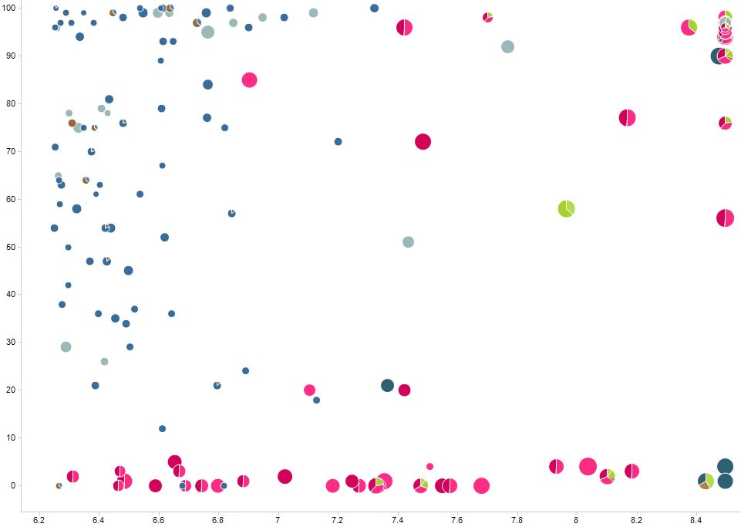

Framework Overlaps in Related Molecules Reveal Substructures Associated with Activity
Hit
Prioritization
Each pie is one compound
Each sector/color is one framework
Exemplar compounds
Framework not active in 3D7 strain; not found by R-group tool
Framework
moderately
active
Percent inhibition in DD2 (PF resistant strain)
Frameworks
active and
overlapping
Color by:
Framework
Sector size:
# molecules
Size by:
Ligand
Efficiency (PF 3D7)
pIC50 in 3D7 (PF susceptible strain)
Notes:
Preprocessed substructure search: which substructure encodes activity?

Slide 15
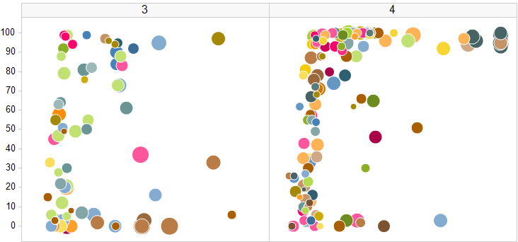
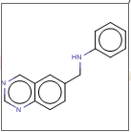

Scaffold Networks Example: Identify Related Scaffolds with a Desirable Profile
Scaffold
Hopping
?
Find new bicyclic and tricyclic scaffolds
active against resistant DD2 strain
RINGS =
RINGS =
… possibly more layers with higher # rings …
Percent inhibition in DD2 (resistant strain)
Trellis by:
# rings in scaffold
Color by:
Top-Level Scaffold
Size by:
Ligand Efficiency (PF 3D7)
pIC50 in 3D7 (PF susceptible strain)
Original tricyclic scaffold inactive against resistant DD2 strain

Slide 16
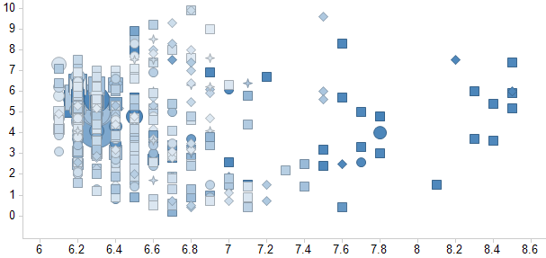

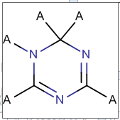

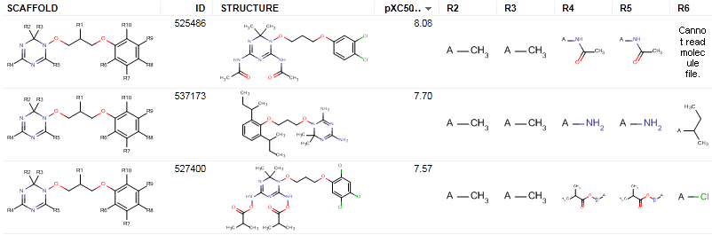
NCATS R-Group Tool Connects Molecules to Scaffolds with Aggregate Data and Drill-Down
5.7k scaffolds, filtered to 428 by max pIC50
Minimum # of “useful” scaffolds
Tautomers under single scaffold
Avg. IFI
Avg. pIC50 in 3D7 (PF sensitive strain)
Bonus: sensible R-group tables generated

Slide 17

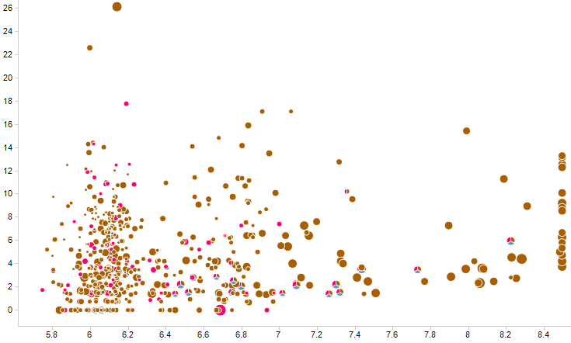

NCATS R-Group Tool Example: Deconstruct SAR of Related Molecules
Scaffold
Hopping
?
Each pie is one compound
Each sector/color is one scaffold
Indazoles
alone only
weakly active
Discover alt. tricycles
IFI
Quinazolines
alone active,
ligand efficient
Fuse Design Ideas
pIC50 in 3D7 (PF susceptible strain)
Size by Ligand Efficiency (3D7)

Slide 18

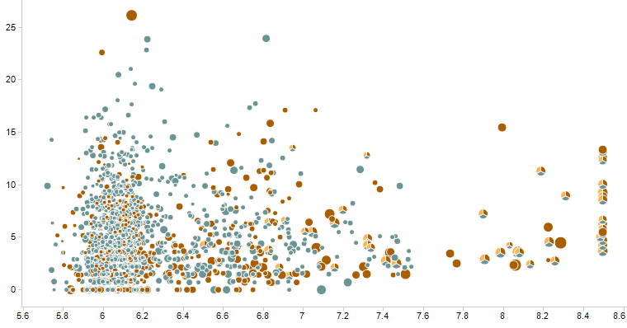
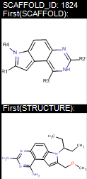
NCATS R-Group Tool Example: Iterative SAR Exploration
Scaffold
Hopping
?
Each pie is one compound
Each sector/color is one scaffold
New tricycle scaffold
(1824) seems more
active than indoles or
quinazolines alone
IFI
pIC50 in 3D7 (PF susceptible strain)
Size by Ligand Efficiency (3D7)
Notes:
10 sec. short script

Slide 19
Scaffold-Based Decision Making and Hit ID Integration
Dataset
Integration
Kinase “X”
Candidate compound demonstrates exquisite kinase selectivity
Active against Wild-Type, Inactive against Mutant enzyme
Backup program
New screens analyzed & integrated using NCATS R-Group Tool
2011 2012 2014 (backup)
Fragment hits 288 pIC50s
HTS 2012 2M screened 4564 pIC50s
HTS 2014 350K top-up 3613 pIC50s
DNA ELT
130 libraries 824 features
9259
cpds
Activity data available
No activity data
Goal: identify selective backup series from new Hit ID efforts
Notes:
We used the scaffolds to merge all of this data and identify more series that bind selectively

Slide 20
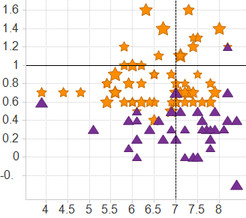
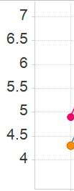
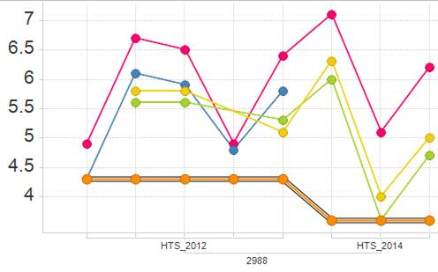
Selective Lead Series Linked Across Datasets
Dataset
Integration
Scaffold classification by mutant binding
Scaffold-Level Details:
Statistics for 8 exemplars Mech. pIC₅₀: 6.0 ± 0.88
Cell pIC₅₀: 5.3 ± 0.81
LE: 0.35 ± 0.05
Mean Δ( WT pIC₅₀ – mutant pIC₅₀ )
Assay Drill-Down:
Selective WT/mut.
2014
2012
Non-selective
Mechanistic
Size: pIC50
pIC₅₀
Full-length WT
Truncated WT
Cell
Mean PFI_{pred}
Mutant
Mech. pIC₅₀: 7.1
Cell pIC₅₀: 6.3
LE: 0.44
GSK Compound ID
Chemistry initiated on series!
HTS 2014 hit
HTS 2012 hit (not followed up)

Slide 21

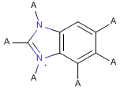
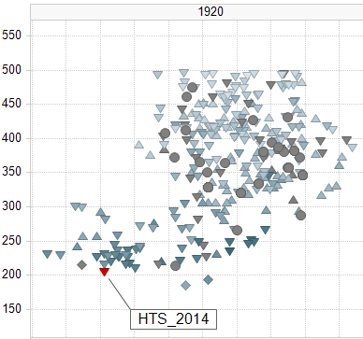
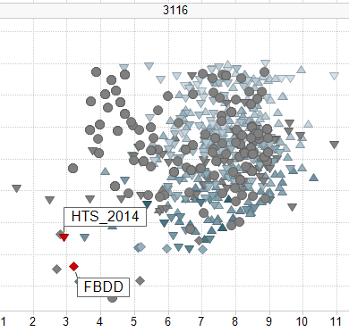


Identify and Test Unmeasured Compounds Based on Overlap with Actives Across Datasets
Dataset
Integration
Weak active for Kinase “X”
Trellis by Scaffold
Color by LE
MW
Shape by:
Ligand-
efficient
HTS hit
Ligand-efficient
HTS and
fragment hits
PFI
PFI

Slide 22
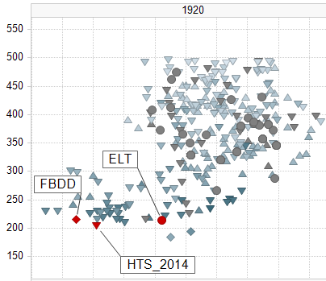
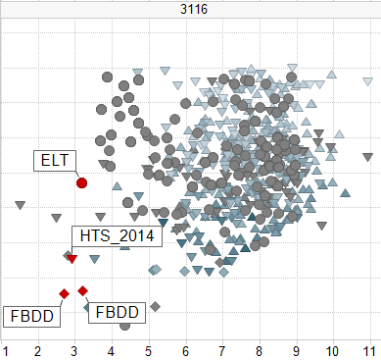
Identify and Test Unmeasured Compounds Based on Overlap with Actives Across Datasets
Dataset
Integration
Weak active for Kinase “X”
Trellis by Scaffold
Color by LE
Low MW/PFI
ELT feature
to synthesize
Low MW/PFI
ELT feature
to synthesize
MW
Shape by:
Low
MW/PFI
untested
fragment
Low
MW/PFI
untested
fragment
Ligand-
efficient
HTS hit
Ligand-efficient
HTS and
fragment hits
PFI
PFI
Notes:
Key message: prioritize ELT with no activity data, just based on overlap with actives from other datasets

Slide 23
Conclusions and Future Directions
Merging datasets using scaffolds enables a cohesive visualization of chemical series and suggests opportunities for hybridization
Automated scaffold and R-group generation is a powerful way to prioritize hits and replace scaffolds in large and diverse datasets
Partitioning into clusters is ambiguous, incomplete for SAR navigation.
Scaffold-Generation Methods (Frameworks, Scaffold Networks, NCATS R-Group Tool) have their differences, pros and cons
All methods revealed similar insights from the TCAMS dataset
Future improvements:
Scalability to larger and ever-changing datasets
Automated selection of informative overlapping scaffolds
Combining multiple scaffold-generation methods

Slide 24
Thank You & Questions

Slide 25
Backup and References
Scaffold Generation Methods:
NCATS R-group analysis (http://tripod.nih.gov/?p=46 )
Frameworks (Data-Driven Clustering, GSK/ChemAxon)
Scaffold Network Generator (http://swami.wustl.edu/sng)
Agglomerative Clustering (Complete Linkage, GSK/ChemAxon)
NCATS R–group tool @ http://tripod.nih.gov
G. Harper, G. S. Bravi, S. D. Pickett, J. Hussain, and D. V. S. Green. J. Chem. Inf. Comput. Sci., 44(6), 2145-2156 (2004)
M. K. Matlock, J.M. Zaretzki, and S. J. Swamidass. Bioinformatics. 29(20), 2655-2656 (2013).

Slide 26

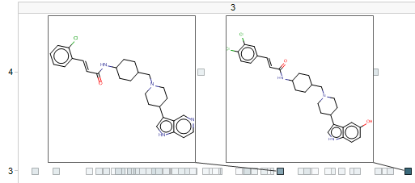
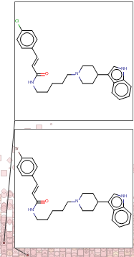
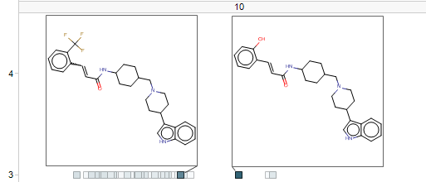
Hit Prioritization via Clustering: Exploration within Pre-determined Groups Only
Hit
Prioritization
~2000 complete linkage clusters in TCAMS set
Initial clustering limits neighbors you can discover
Query molecules (scatter plot)
IFI
# aromatic rings
Percent inh. in DD2 (PF resistant strain)
pXC50 in 3D7 (PF susceptible strain)
Notes:
This slide can be backup.

Slide 27



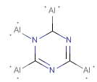
Using GSK Frameworks
80k GSK frameworks, 7.5k RECAP fragments in TCAMS set
Score of a framework = Average activity of molecules containing it
Low scoring frameworks can be filtered out
Issues identified:
Many equivalent and redundant frameworks
Tautomers not unified by current implementation

Slide 28
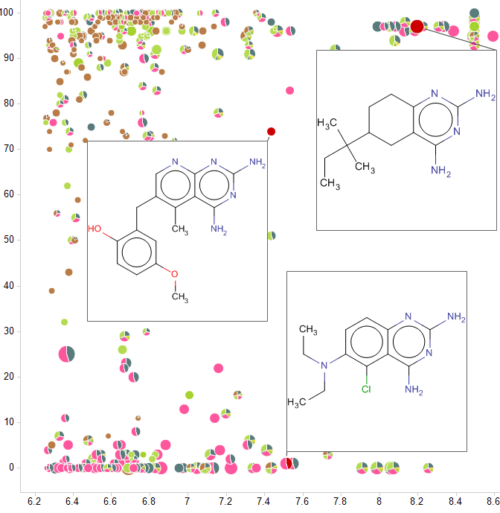
Related Molecules with Framework Overlaps: Reveal Potential Scaffold Hops
Scaffold
Hopping
?
Each pie is one compound
Each sector/color is one framework
Shared framework,
Related chemotypes
Opportunity to design hybrid series
Percent inhibition in DD2 (PF resistant strain)
Color by:
Framework
Sector size:
# molecules
Size by:
Ligand
Efficiency
Molecule
Scaffold(s)
Related Molecules
pXC50 in 3D7 (PF susceptible strain)
Notes:
Automated substructure search to find part of molecule that’s active. Backup?

Slide 29
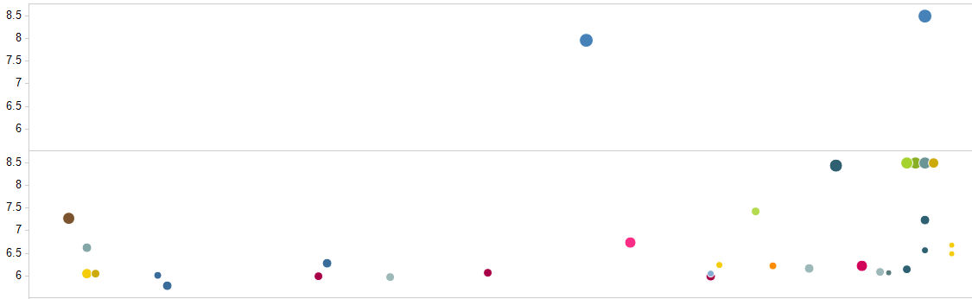
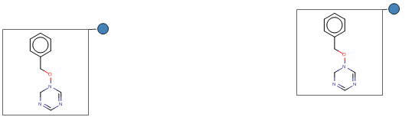
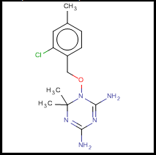
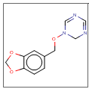
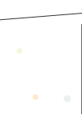
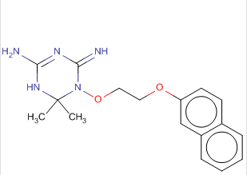
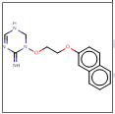
Hit Prioritization via Scaffold Networks: Navigate to Related Scaffolds
Hit
Prioritization
13.5k compounds map to 7715 top-level scaffolds (28.5k total)
Rings
Color by:
Top-Level Scaffold
Size by:
Ligand Efficiency
Trellis by:
Number
of rings in
scaffold
2
pXC50 in 3D7 (PF susceptible strain)
3
Percent inhibition in DD2 (PF resistant strain)
… possibly more layers with higher # rings …
4+
Notes:
Backup

Slide 30
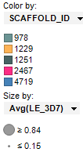



Related Molecules from NCATS R-Group Tool: Visualizing Scaffold Overlap and Activity
Hit
Prioritization
Each pie is one compound
Each sector/color is one scaffold
Scaffold 978 alone
not highly active
Co-occurring
active scaffolds
Scaffold 4719
active by itself
IFI
pXC50 in 3D7 (PF susceptible strain)
Notes:
Backup?

